Slide 1

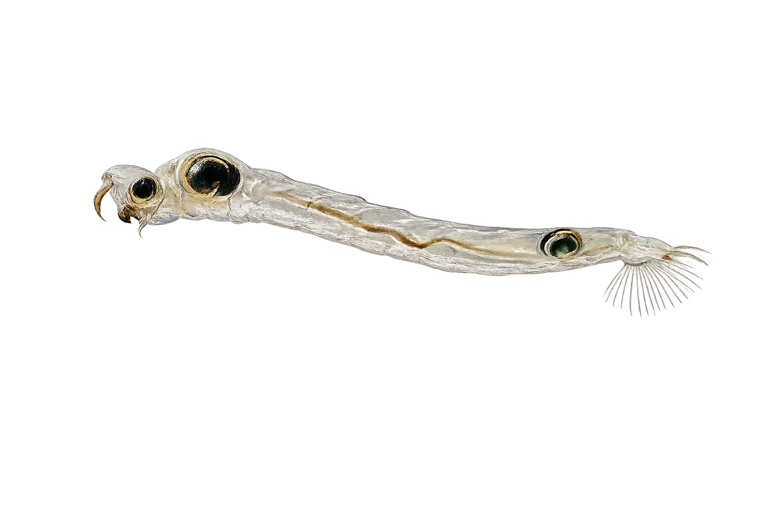

Low-quality toxic
50% Microcystis aeruginosa
50% Tetradesmus obliquus
Low-quality
50% Synechococcus elongatus
50% Tetradesmus obliquus
High-quality
100% Nannochloropsis limnetica
High-quality
100% Nannochloropsis limnetica
Lysed Microcystis aeruginosa

Slide 2
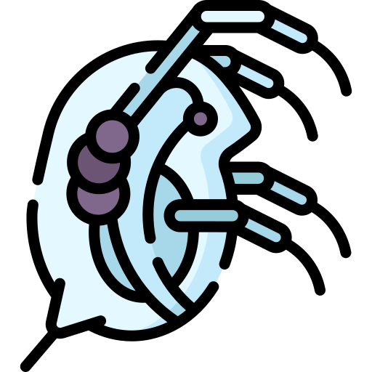
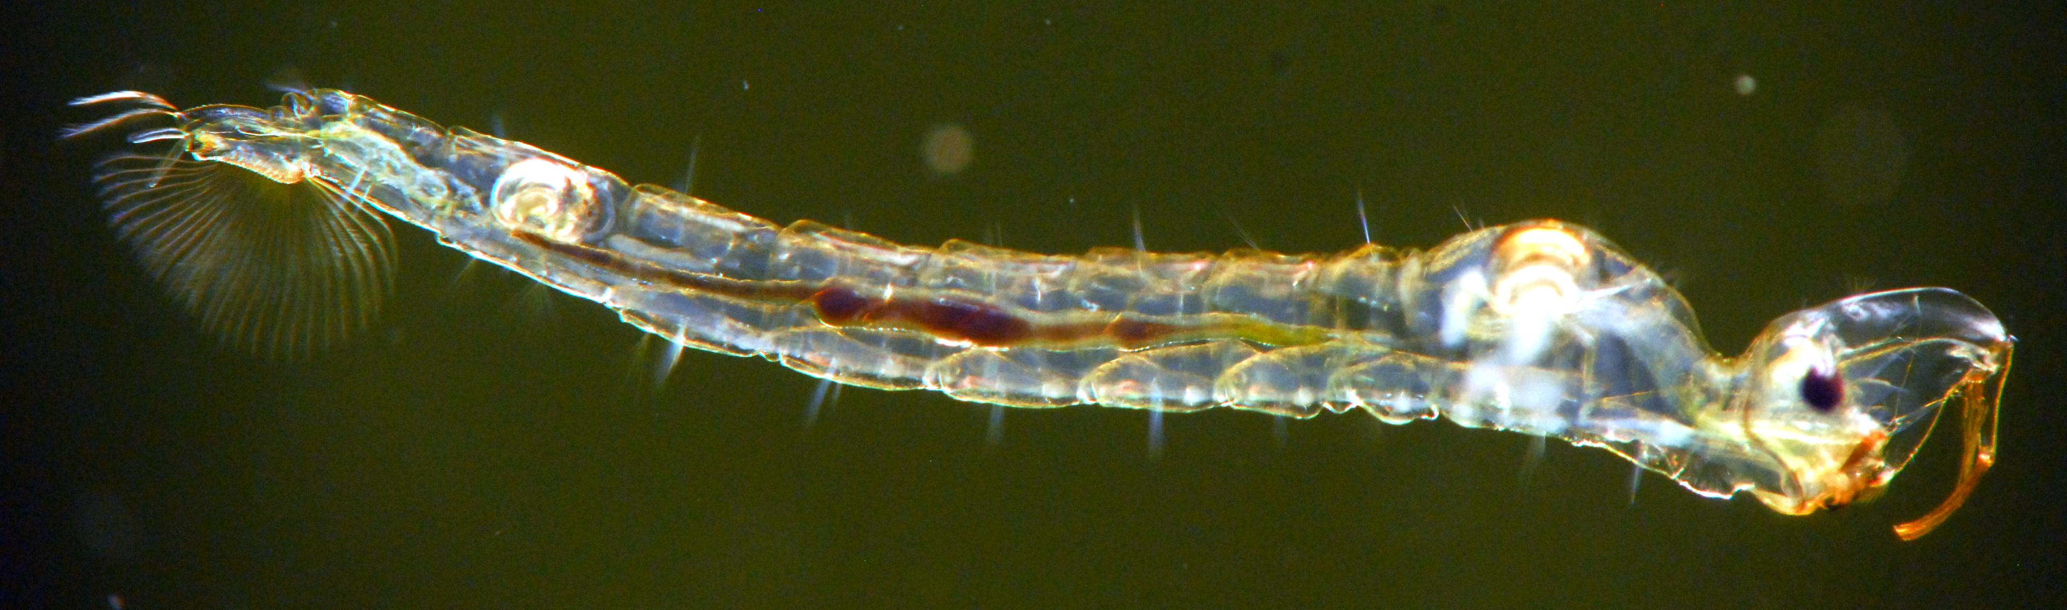

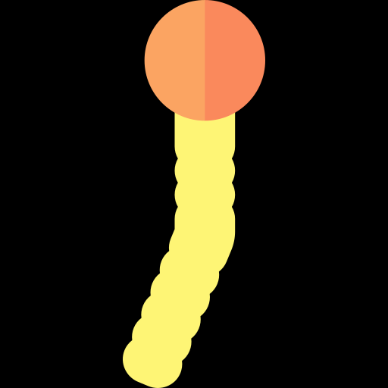

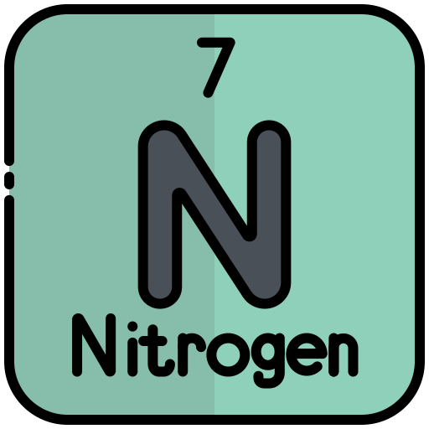
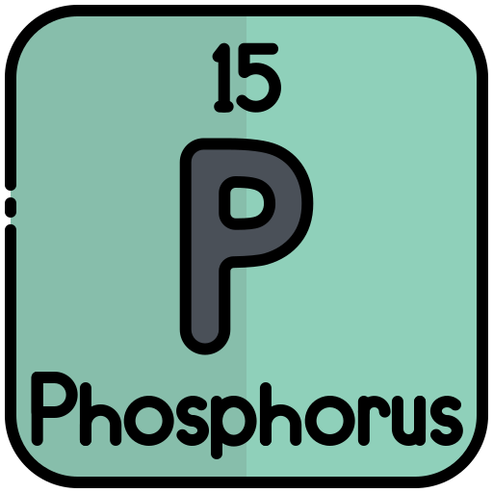

Raise Daphnia
on different diets
Assemble
Throughout experiment
Add
Sample
E.g. treatment
x 200
Death
100 %
50x
E.g. treatment
Quantity
15 Daphnia / jar
x 200
Lysed
Lysed
50 %
Body size
Toxicity
50 %
50 %
x 200
Quality
50 %
Lipids
Stoichiometry
Time to emerge
Timing
Time

